Slide 1
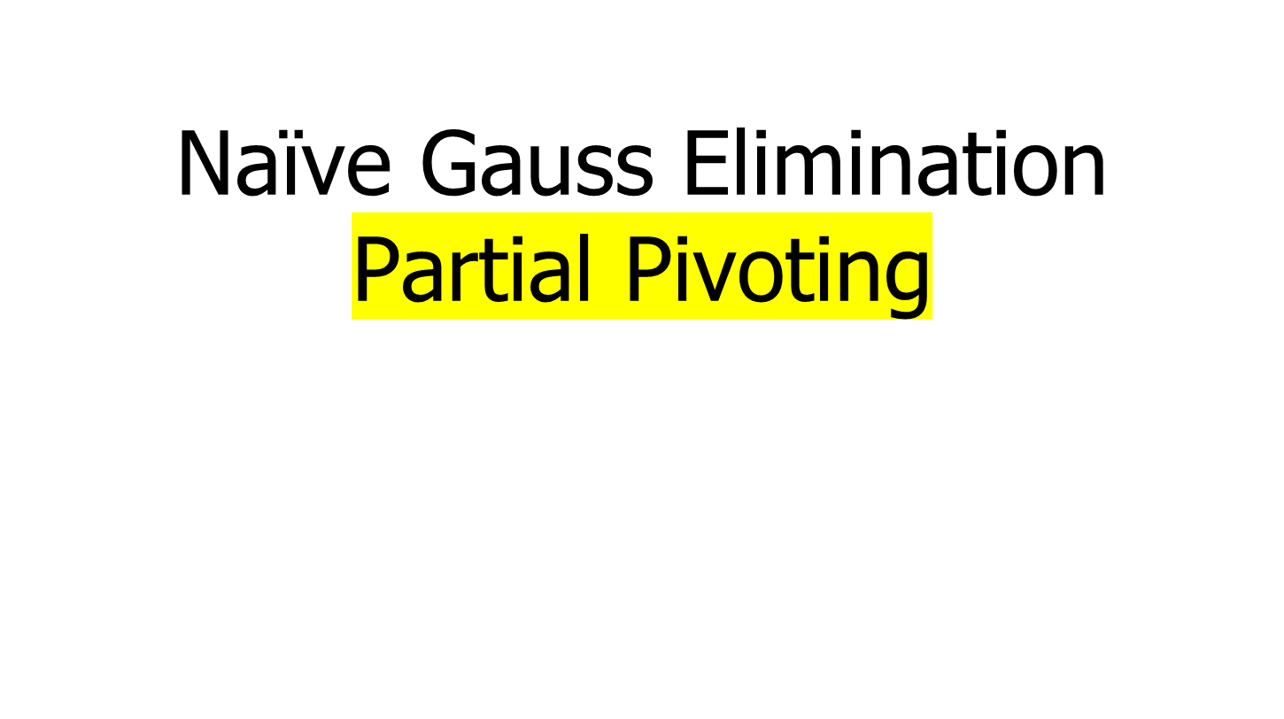
Author: Autar Kaw et. al.
Textbook: TEXTBOOK: NUMERICAL METHODS WITH APPLICATIONS

Slide 2
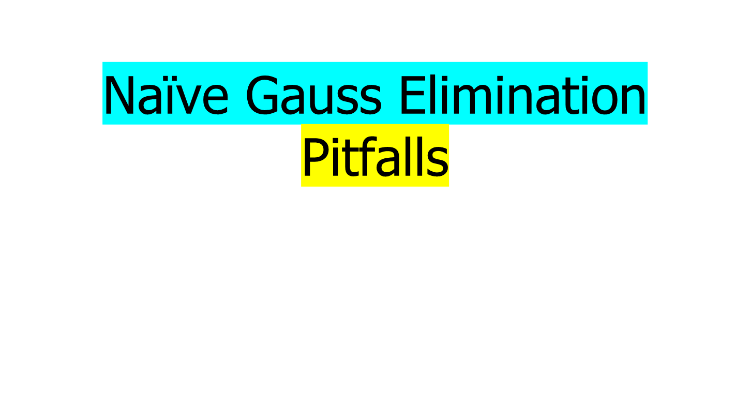

Slide 3

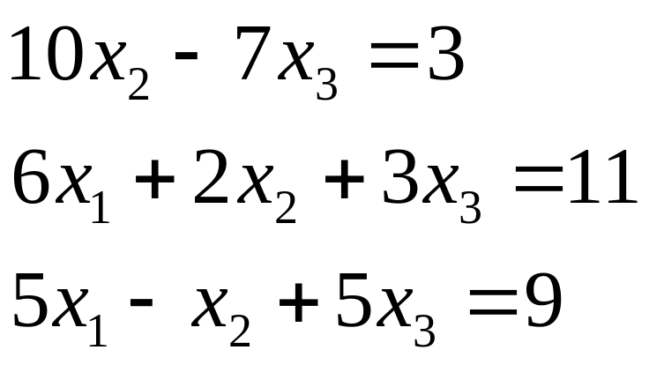
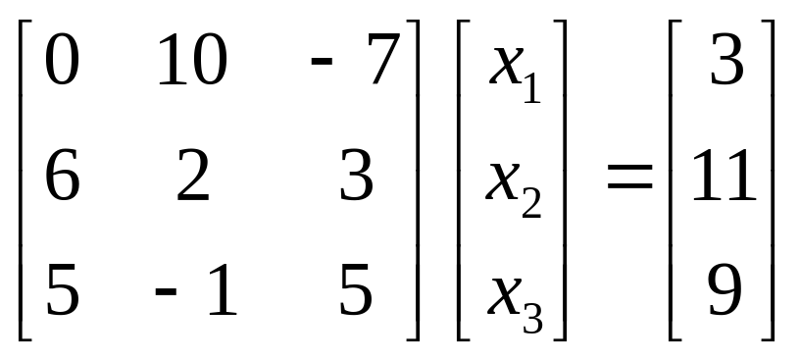

Slide 4
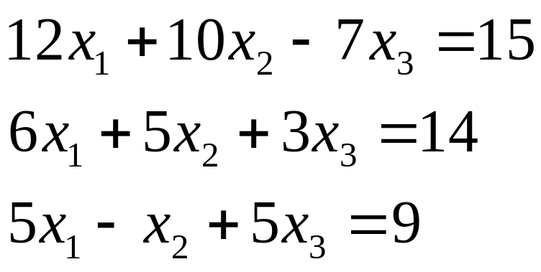
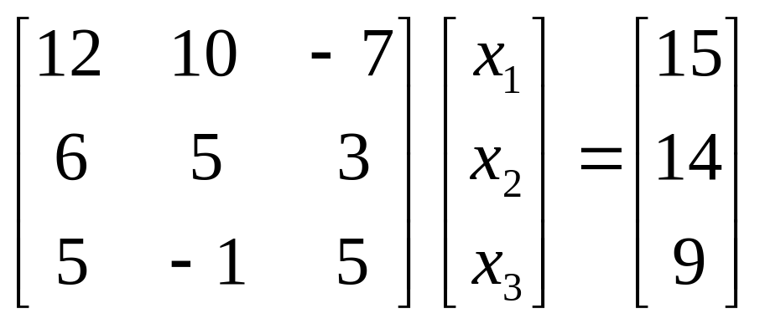
Is division by zero an issue here?

Slide 5
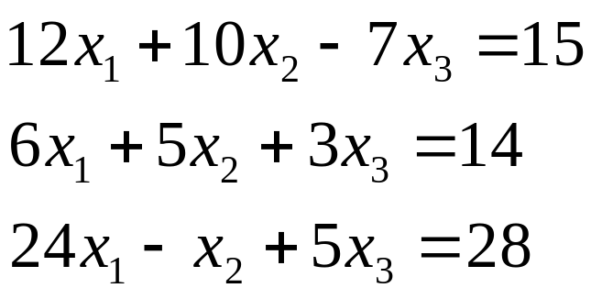
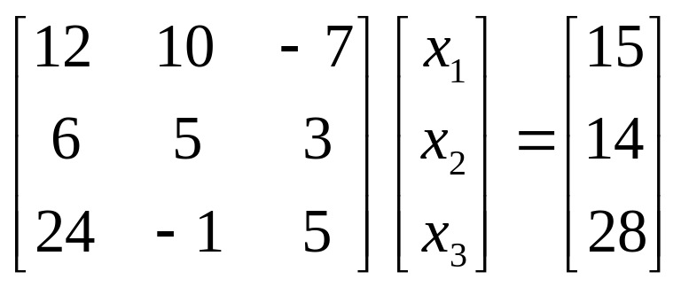
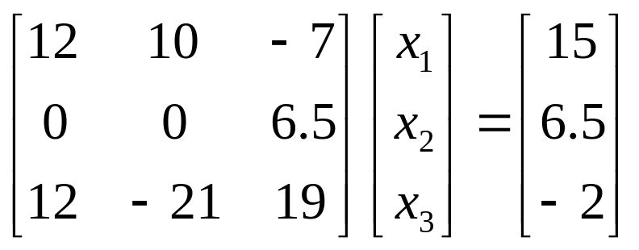
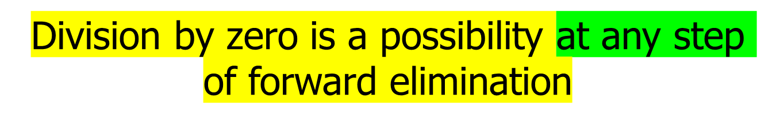
Is division by zero an issue here? YES

Slide 6

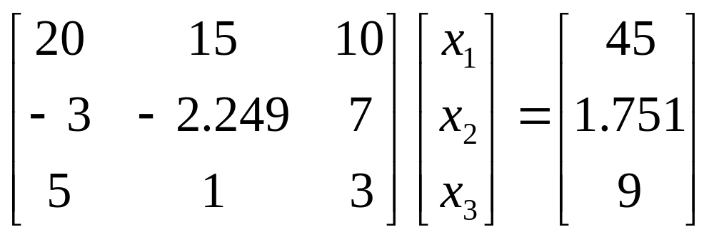
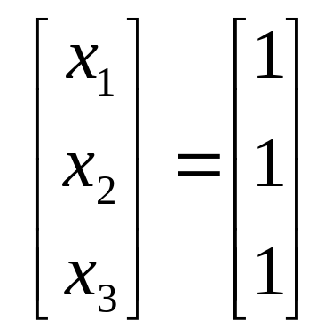
Exact Solution

Slide 7
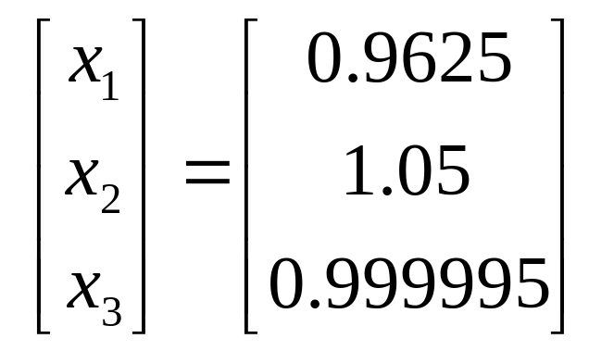
Pitfall#2. Large Round-off Errors
Solve it on a computer using 6 significant digits with chopping

Slide 8
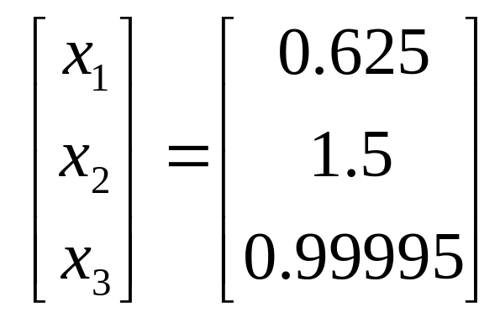
Pitfall#2. Large Round-off Errors
Solve it on a computer using 5 significant digits with chopping

Slide 9

Increase the number of significant digits
Decreases round-off error
Does not avoid division by zero

Slide 10
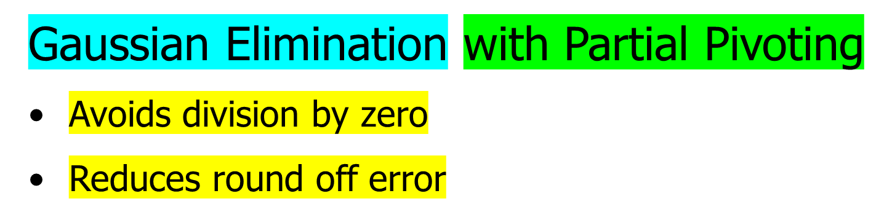


Avoiding Pitfalls

Slide 11


Pitfalls of Naïve Gauss Elimination
Possible division by zero
Large round-off errors

Slide 12
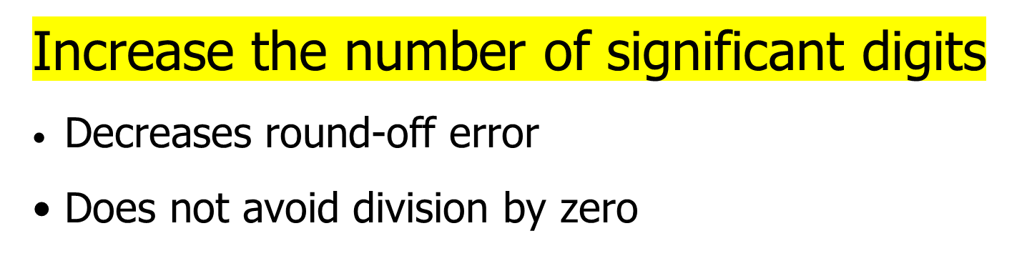


Avoiding Pitfalls

Slide 13
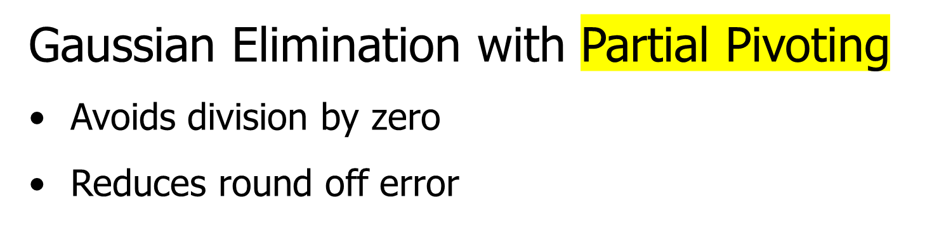


Avoiding Pitfalls

Slide 14
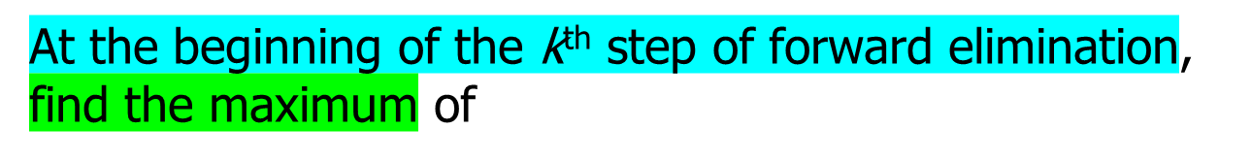
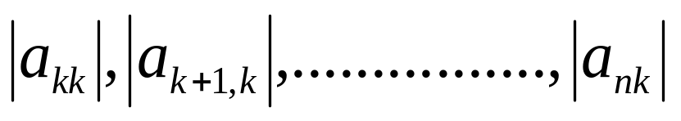





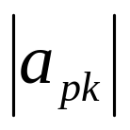

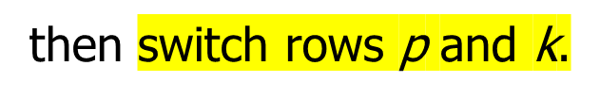
What is Different About Partial Pivoting?
If the maximum of the values is
in the p ^{th} row,

Slide 15
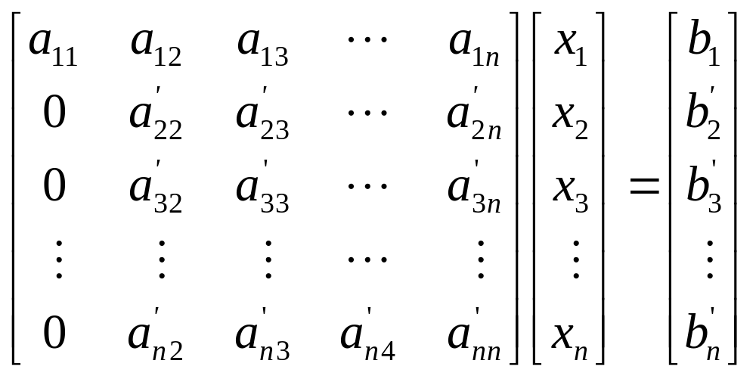
Matrix Form at Beginning of 2nd Step of Forward Elimination

Slide 16
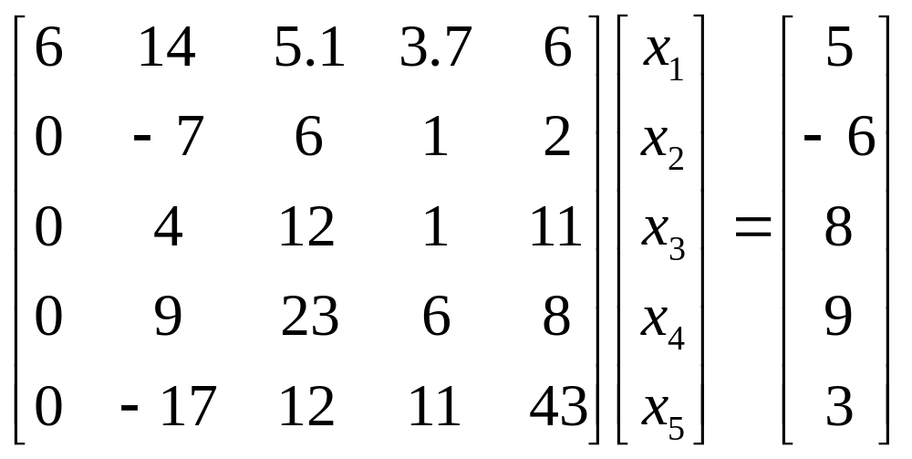


Example (2nd step of FE)
Which two rows would you switch?

Slide 17
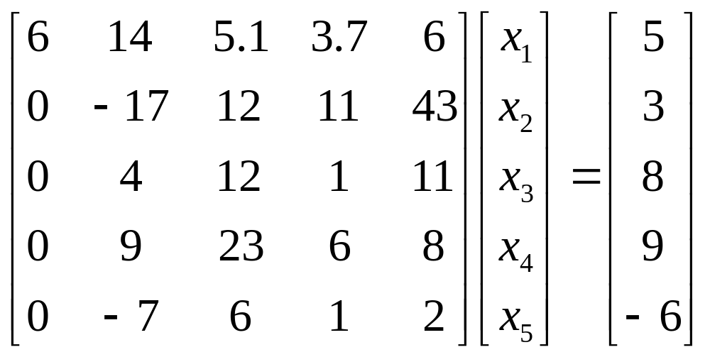
Example (2nd step of FE)
Switched Rows

Slide 18
Gaussian Elimination with Partial Pivoting
A method to solve simultaneous linear equations of the form [A][X]=[C]
Two steps
1. Forward Elimination
2. Back Substitution

Slide 19
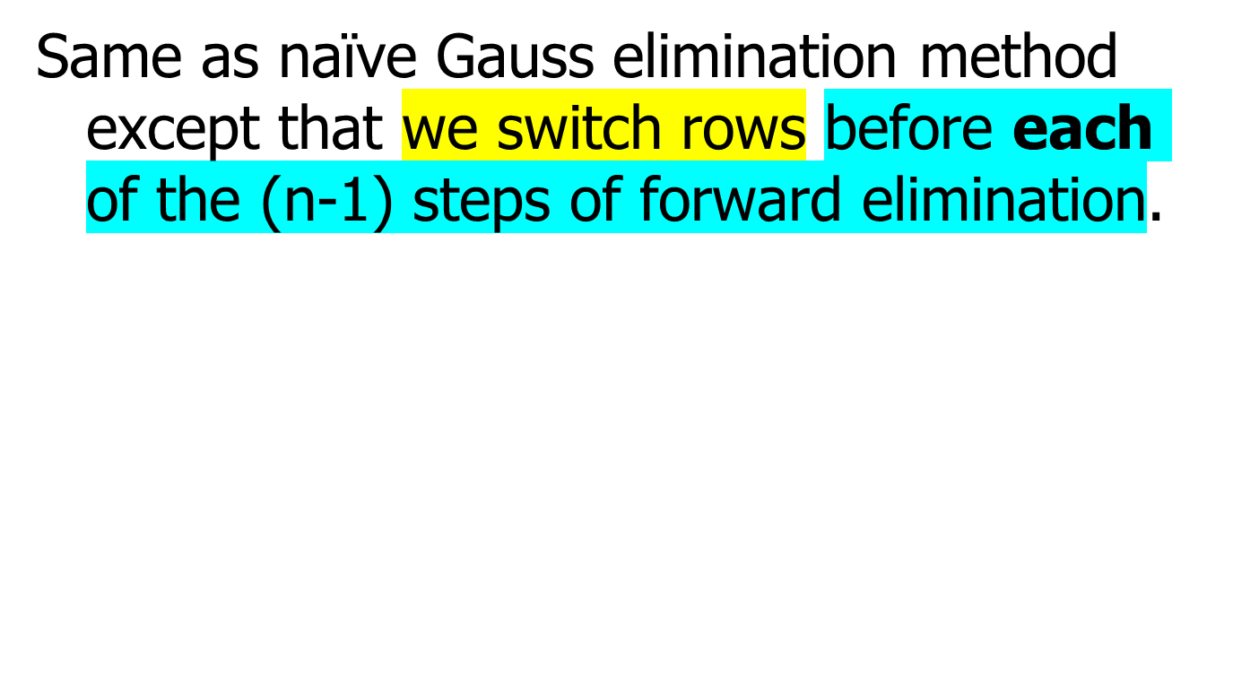
Forward Elimination

Slide 20
Example: Matrix Form at Beginning of 2nd Step of Forward Elimination

Slide 21
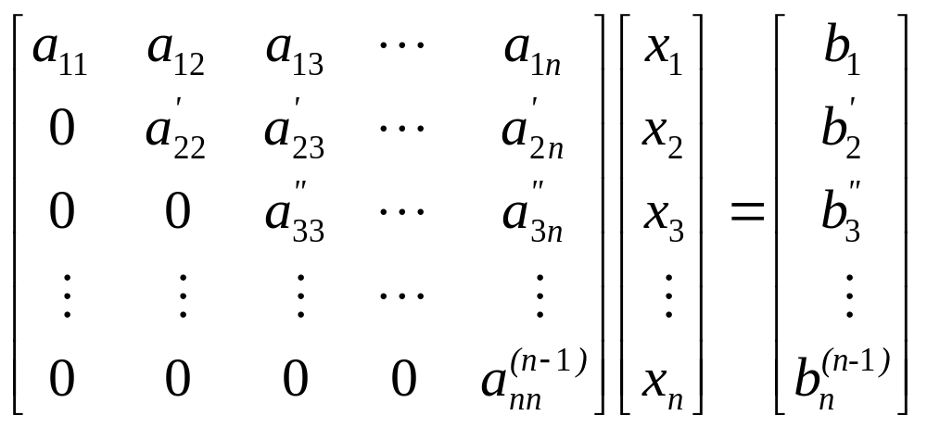
Matrix Form at End of Forward Elimination

Slide 22
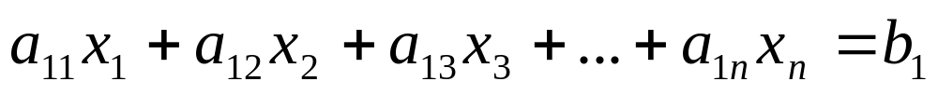
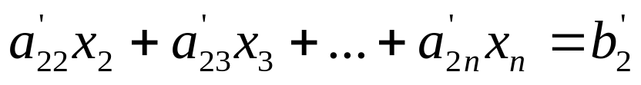
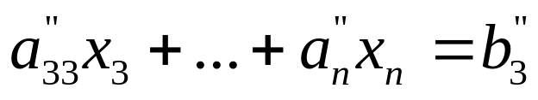

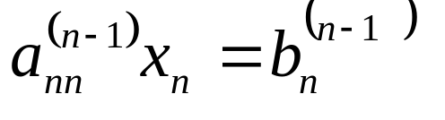

Back Substitution Starting Eqns
. .
. .
. .

Slide 23
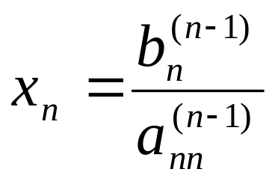

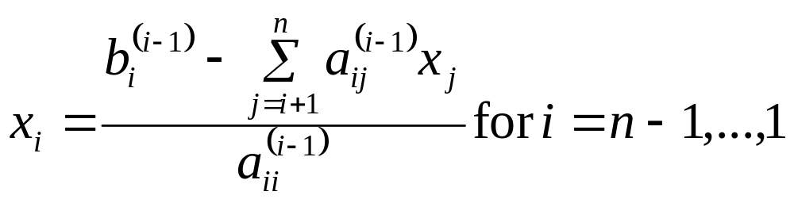



Back Substitution

Slide 24
THE END
http://numericalmethods.eng.usf.edu

Slide 25
Gauss Elimination with Partial Pivoting
Example

Slide 26
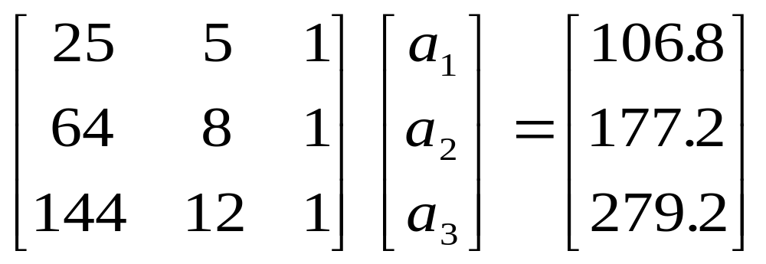
Example 2
Solve the following set of equations by Gaussian elimination with partial pivoting

Slide 27
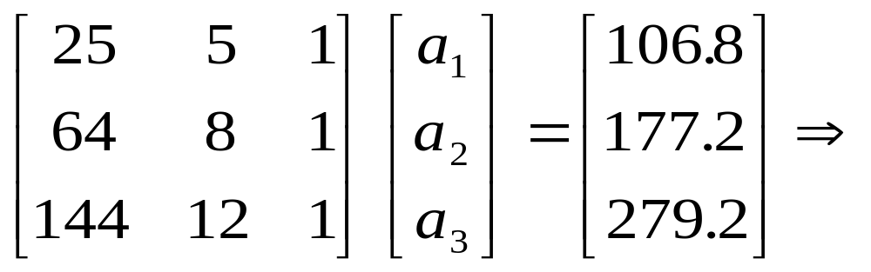
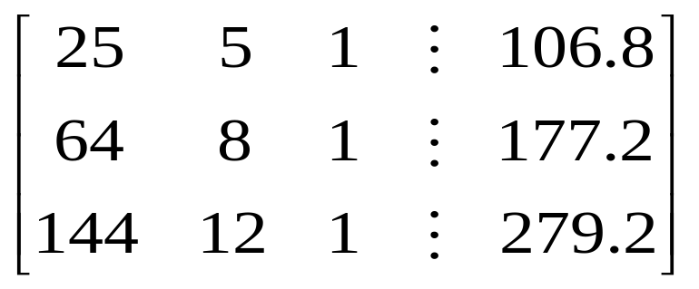
Example 2 Cont.
Forward Elimination
Back Substitution

Slide 28
Forward Elimination

Slide 29


Number of Steps of Forward Elimination
Number of steps of forward elimination is (n−1)=(3−1)=2

Slide 30
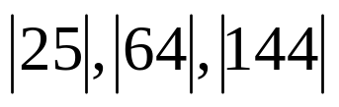
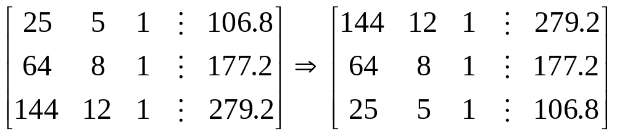
Forward Elimination: Step 1
Examine absolute values of first column, first row
and below.
Largest absolute value is 144 and exists in row 3.
Switch row 1 and row 3.

Slide 31
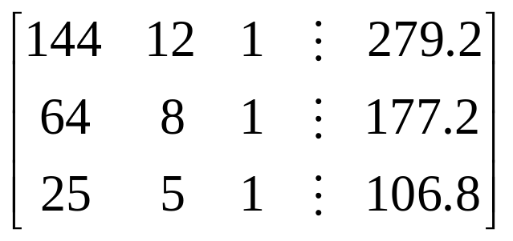
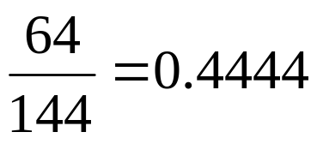
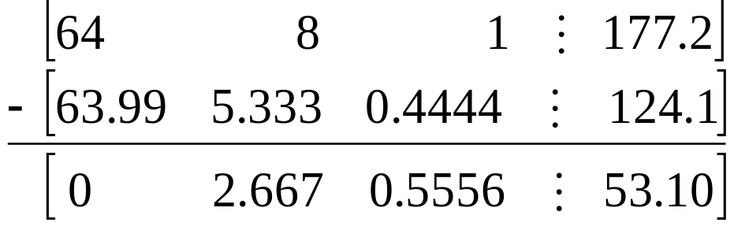
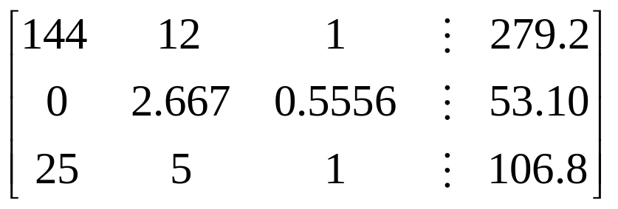
Forward Elimination: Step 1 (cont.)
Divide Equation 1 by 144 and
multiply it by 64, .
.
Subtract the result from Equation 2
Substitute new equation for Equation 2

Slide 32
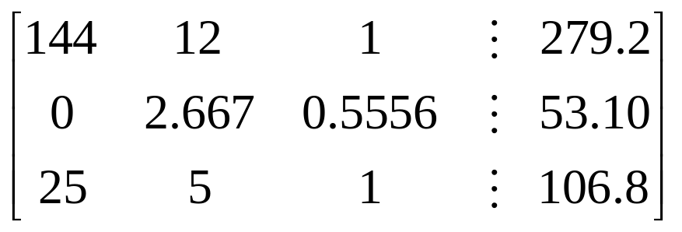
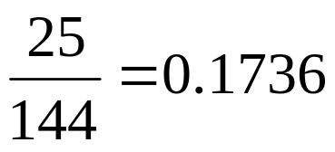
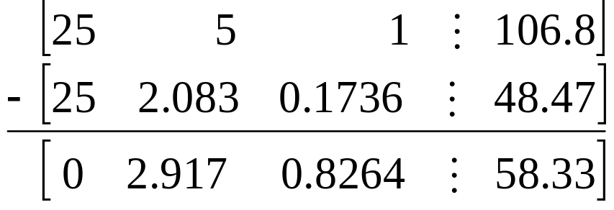
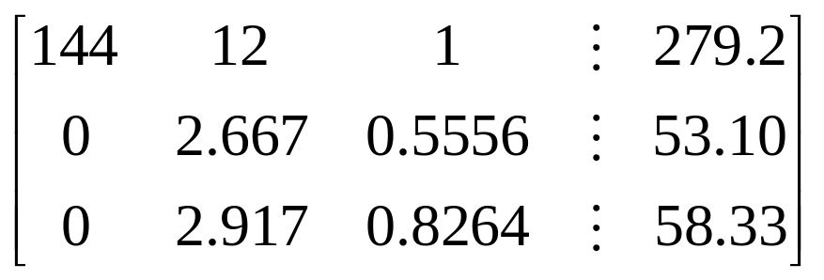
Forward Elimination: Step 1 (cont.)
Divide Equation 1 by 144 and
multiply it by 25, .
.
Subtract the result from Equation 3
Substitute new equation for Equation 3

Slide 33
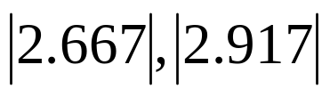
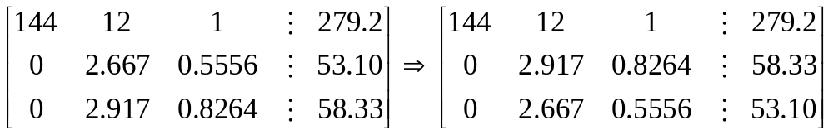
Forward Elimination: Step 2
Examine absolute values of second column, second row
and below.
Largest absolute value is 2.917 and exists in row 3.
Switch row 2 and row 3.

Slide 34
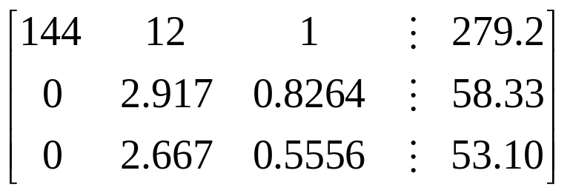
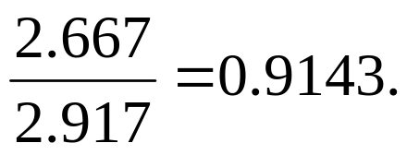
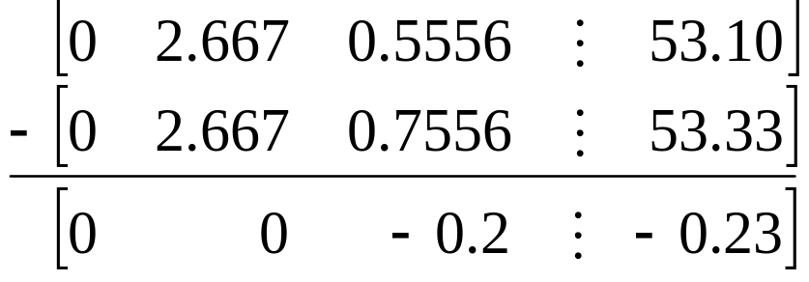

Forward Elimination: Step 2 (cont.)
Divide Equation 2 by 2.917 and
multiply it by 2.667,
.
Subtract the result from Equation 3
Substitute new equation for Equation 3

Slide 35
Back Substitution

Slide 36


Back Substitution
Solving for a₃

Slide 37


Back Substitution (cont.)
Solving for a₂

Slide 38

Back Substitution (cont.)
Solving for a₁

Slide 39



Gaussian Elimination with Partial Pivoting Solution

Slide 40
Gauss Elimination with Partial Pivoting
Another Example

Slide 41




Partial Pivoting: Example
Consider the system of equations
In matrix form
=
Solve using Gaussian Elimination with Partial Pivoting using five significant digits with chopping

Slide 42



Partial Pivoting: Example
Forward Elimination: Step 1
Examining the values of the first column
|10|, |-3|, and |5| or 10, 3, and 5
The largest absolute value is 10, which means, to follow the rules of Partial Pivoting, we switch row1 with row1.
Performing Forward Elimination

Slide 43



Partial Pivoting: Example
Forward Elimination: Step 2
Examining the values of the first column
|-0.001| and |2.5| or 0.0001 and 2.5
The largest absolute value is 2.5, so row 2 is switched with row 3
Performing the row swap

Slide 44

Partial Pivoting: Example
Forward Elimination: Step 2
Performing the Forward Elimination results in:

Slide 45




Partial Pivoting: Example
Back Substitution
Solving the equations through back substitution

Slide 46



Partial Pivoting: Example

Slide 47
THE END

